Slide 1
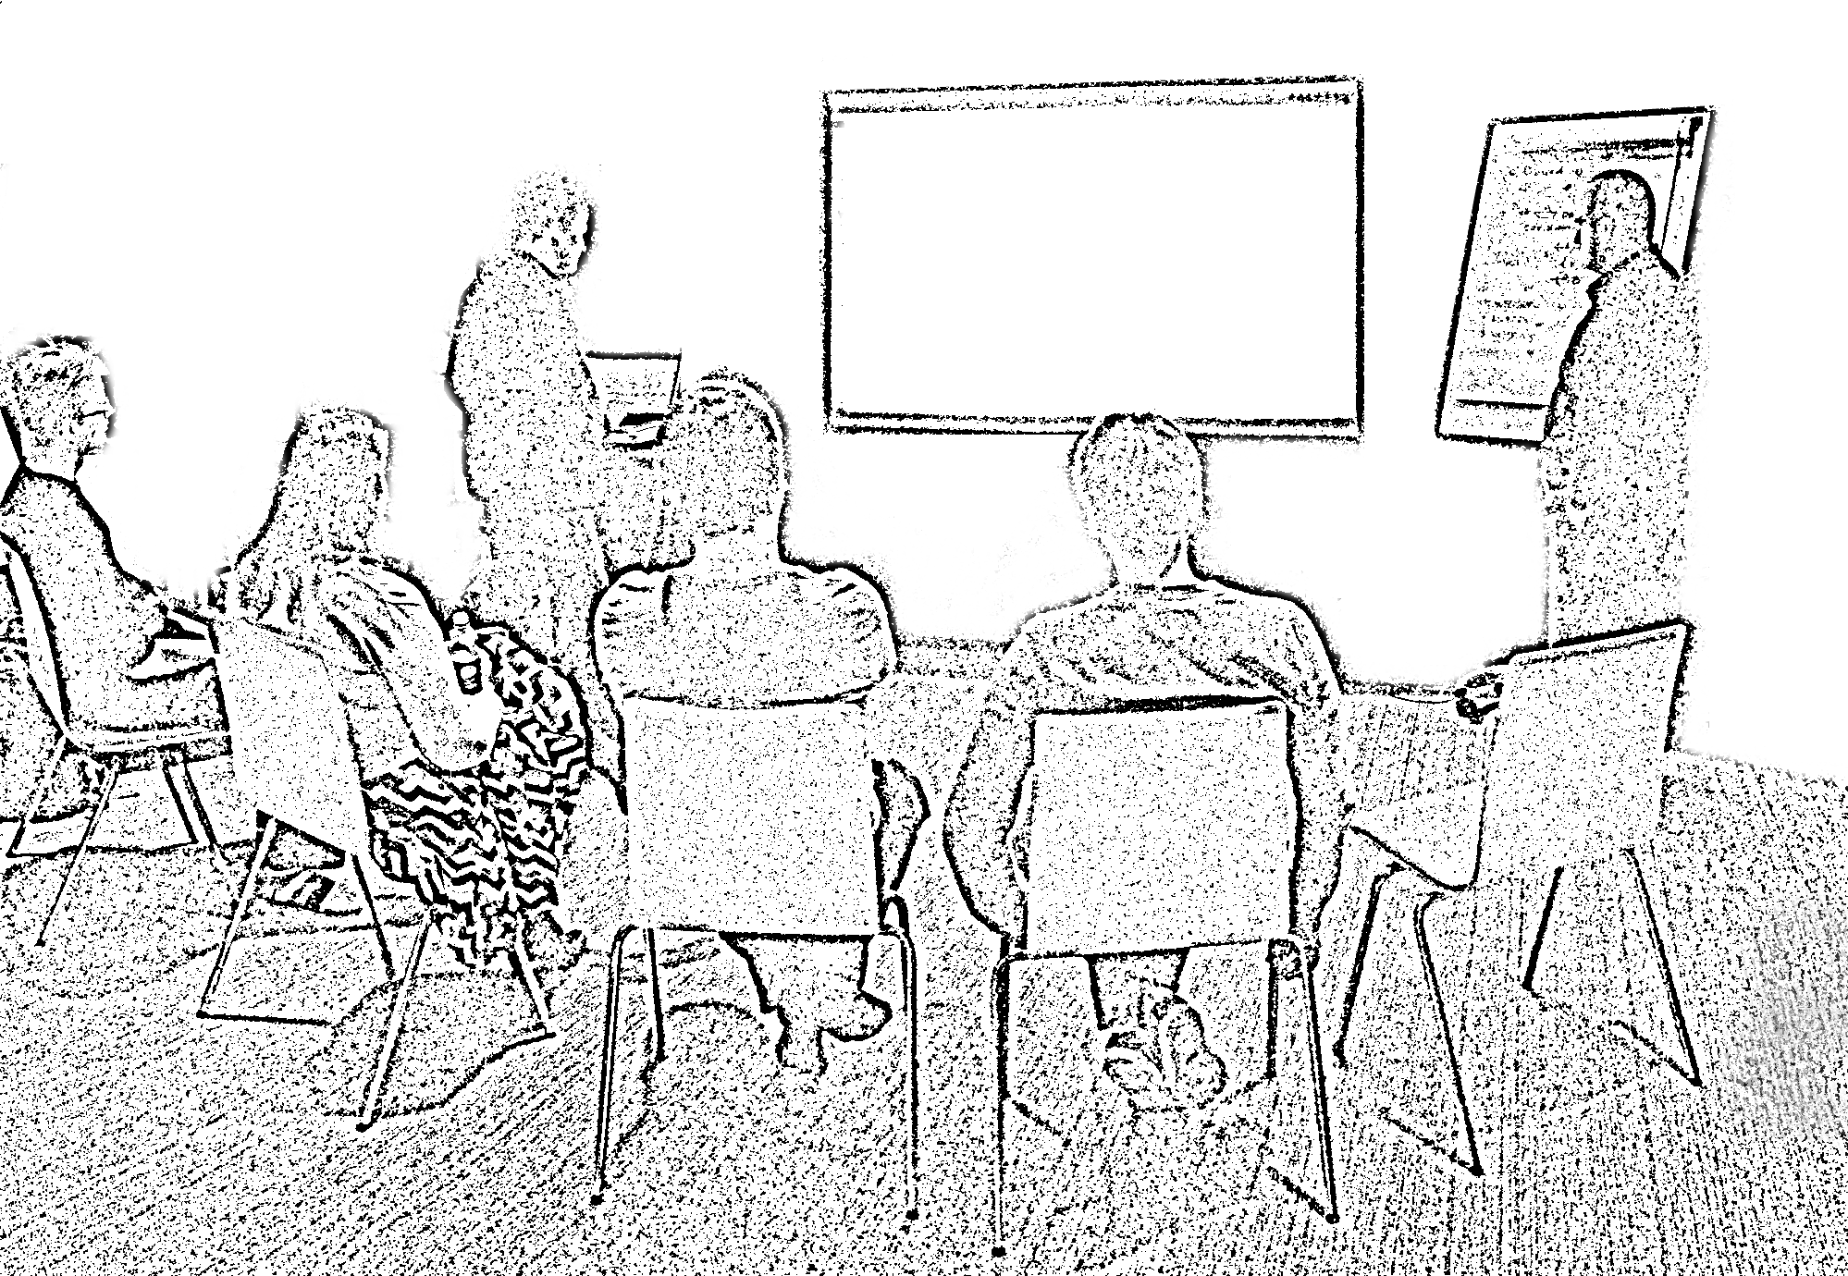
The
Mob Programming
Guidebook

Slide 2
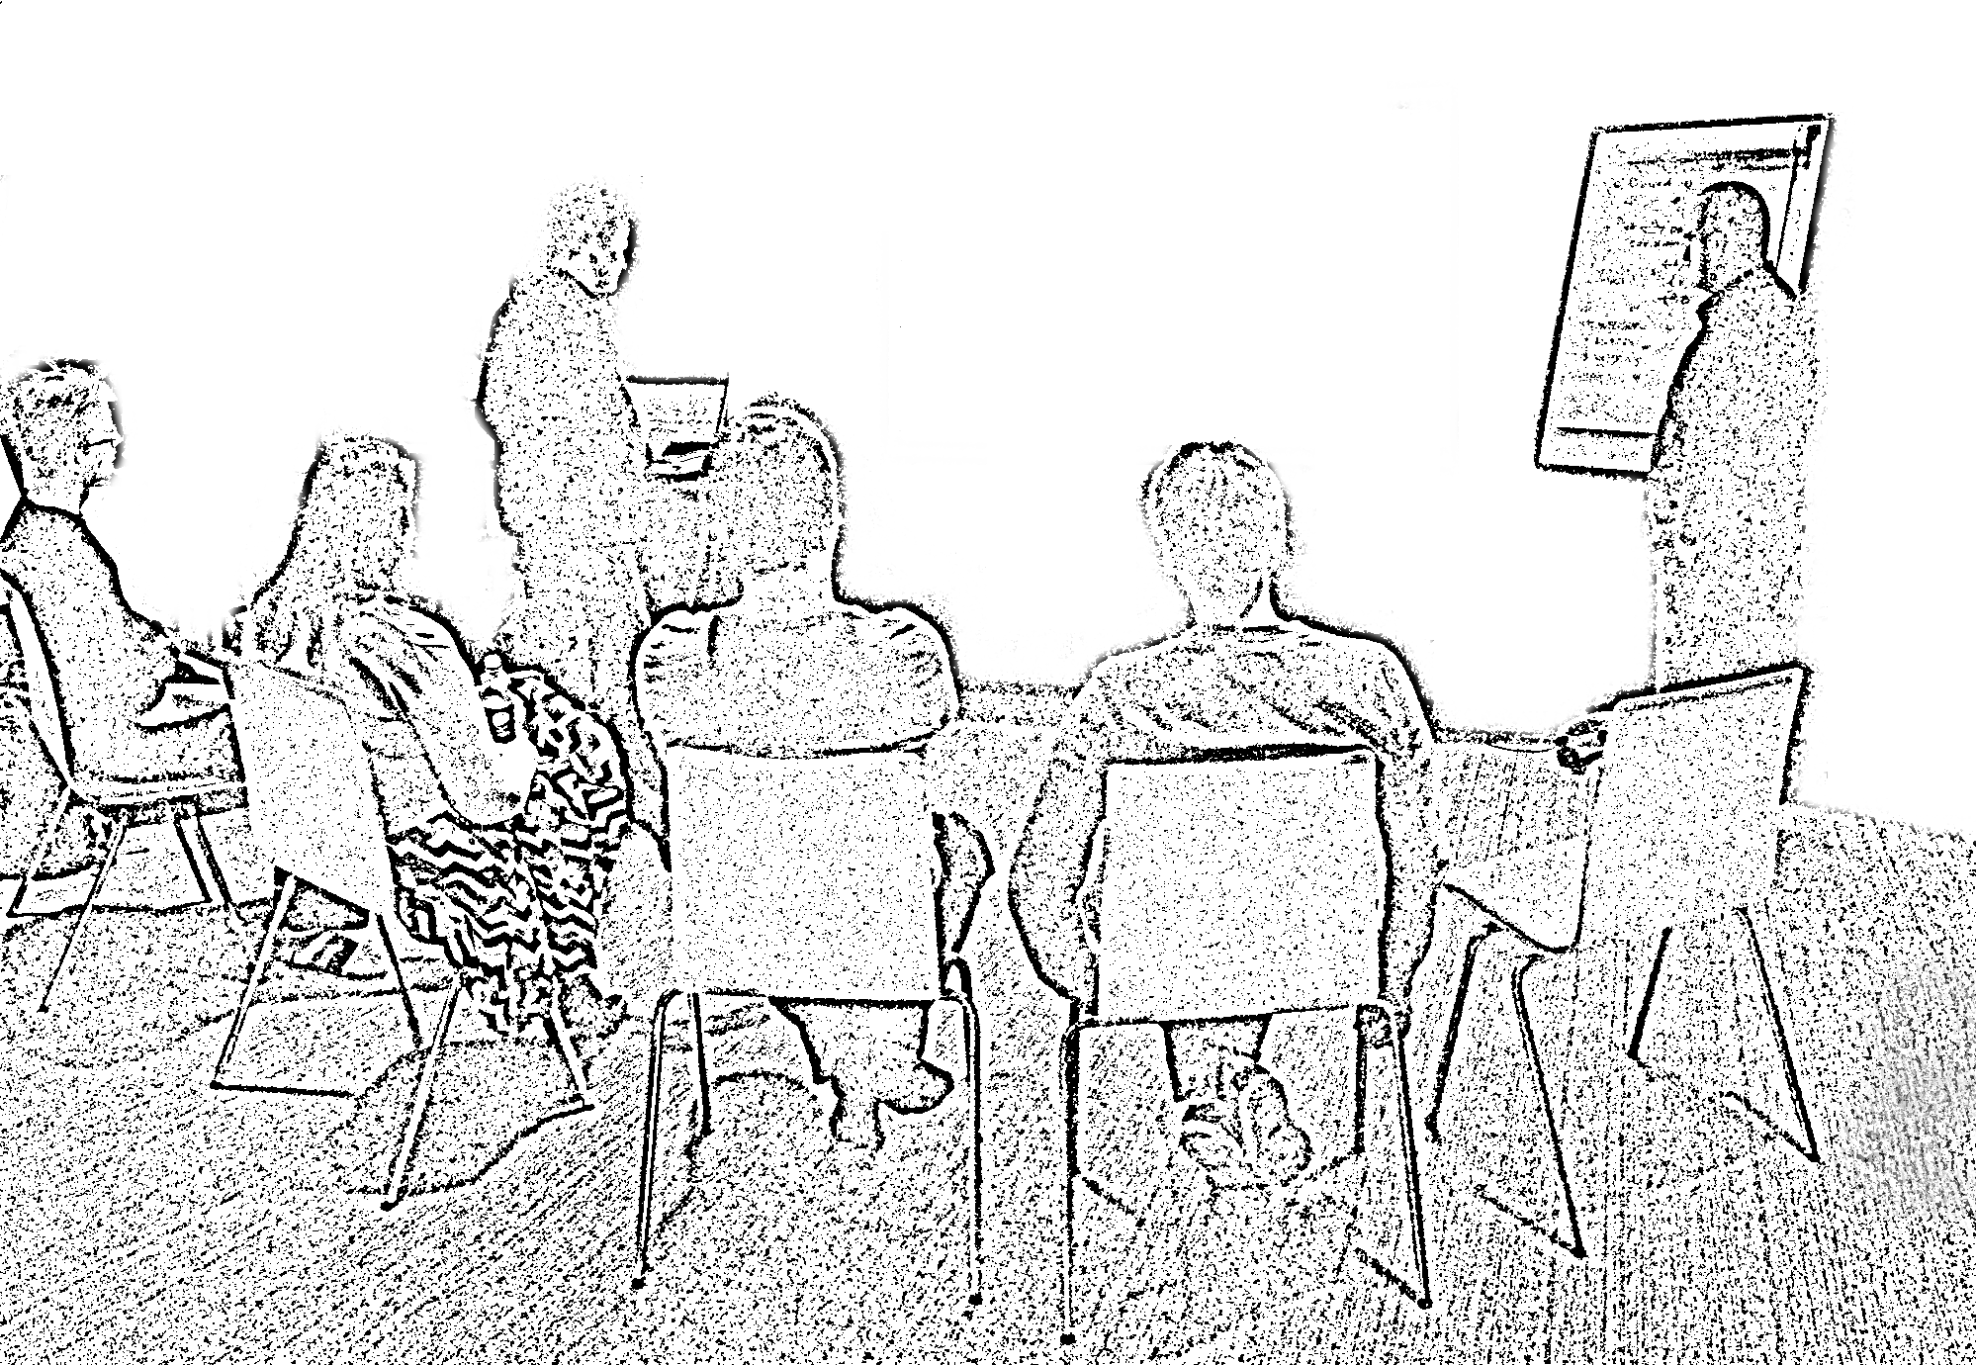
The
Mob Programming
Guidebook
Llewellyn Falco & Maaret Pyhäjärvi

